Slide 1



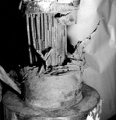




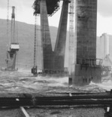




TBA 4125 Prosjektering
K_02:
Understanding structures
Jochen Köhler

Slide 2

Lecture overview
Learning goal:
gain overview about principle structural elements and the functionality
introduce typical structural systems
link to structural mechanics
qualitative load effects on structures
Reading:
Compendium 0 -3

Slide 3
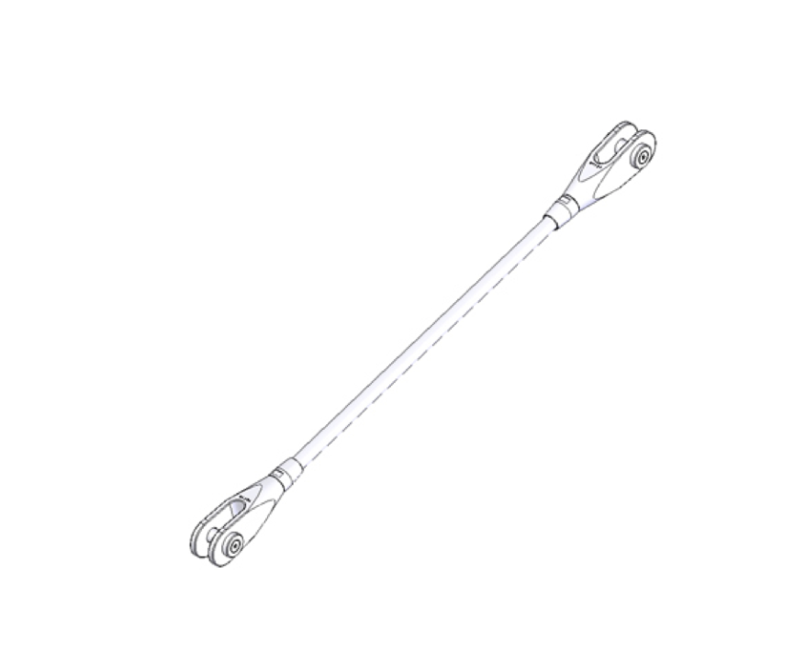
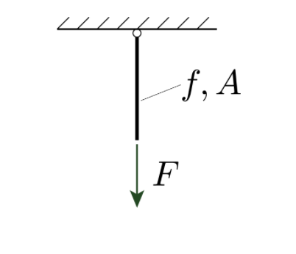

Slide 4
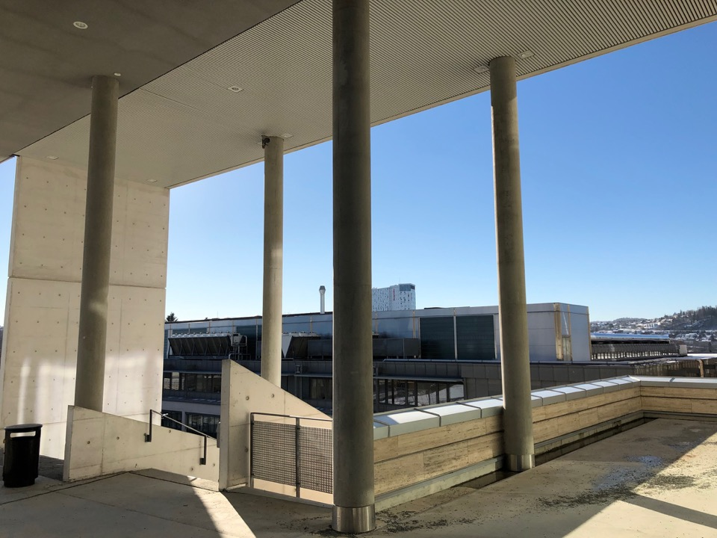

Slide 5
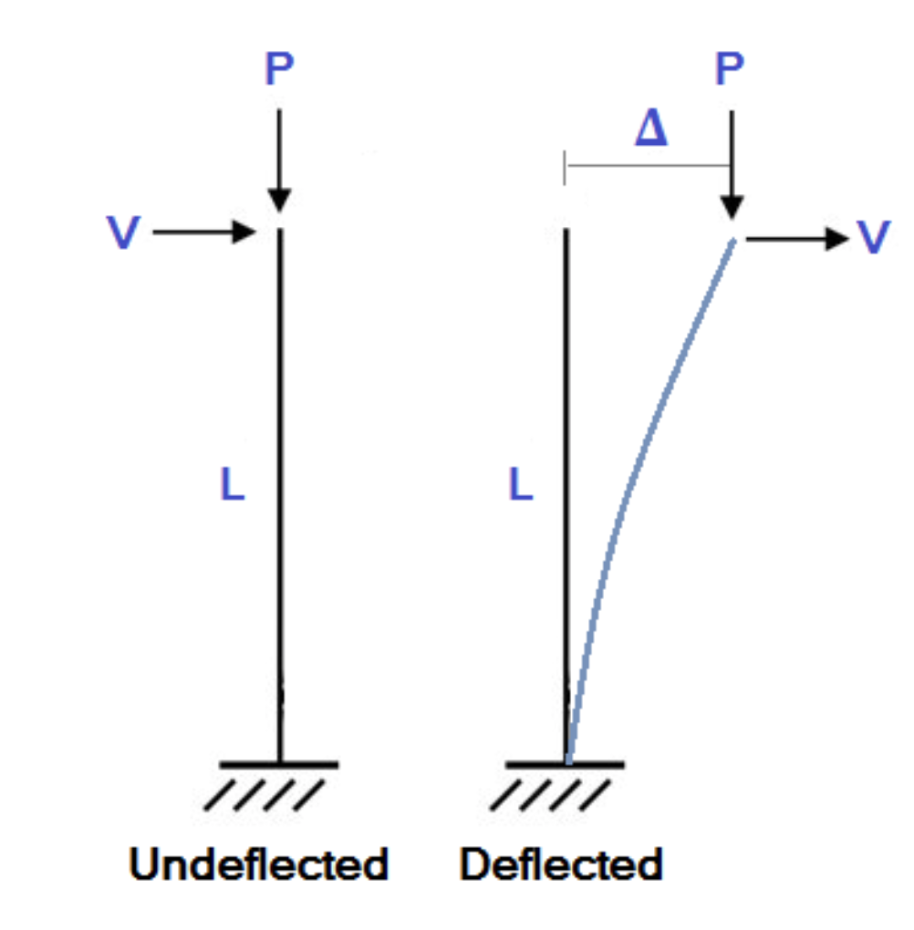

Slide 6
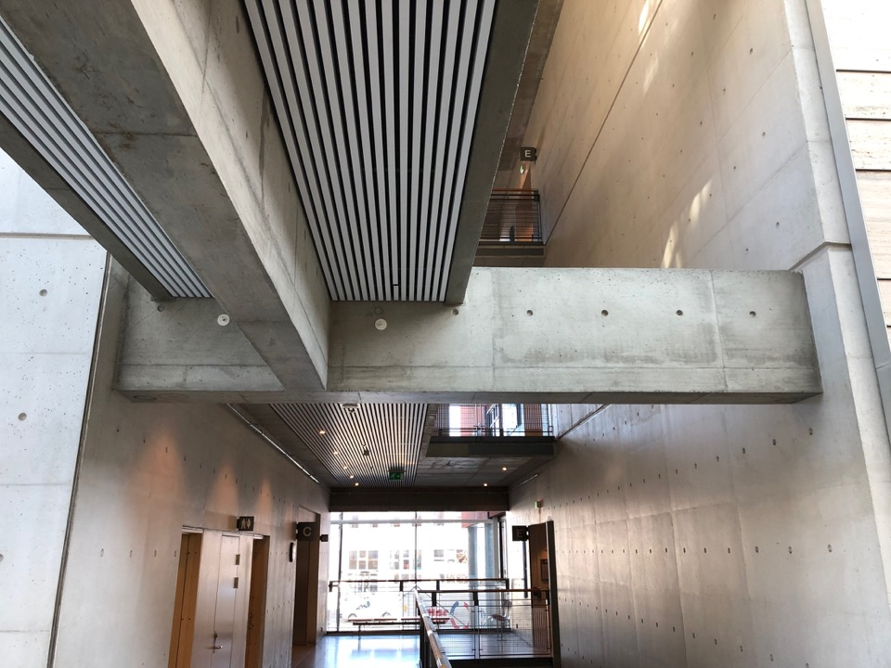

Slide 7
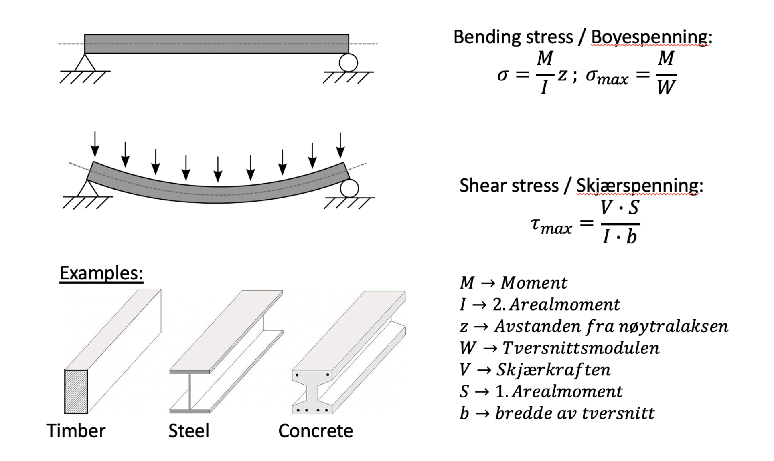

Slide 8
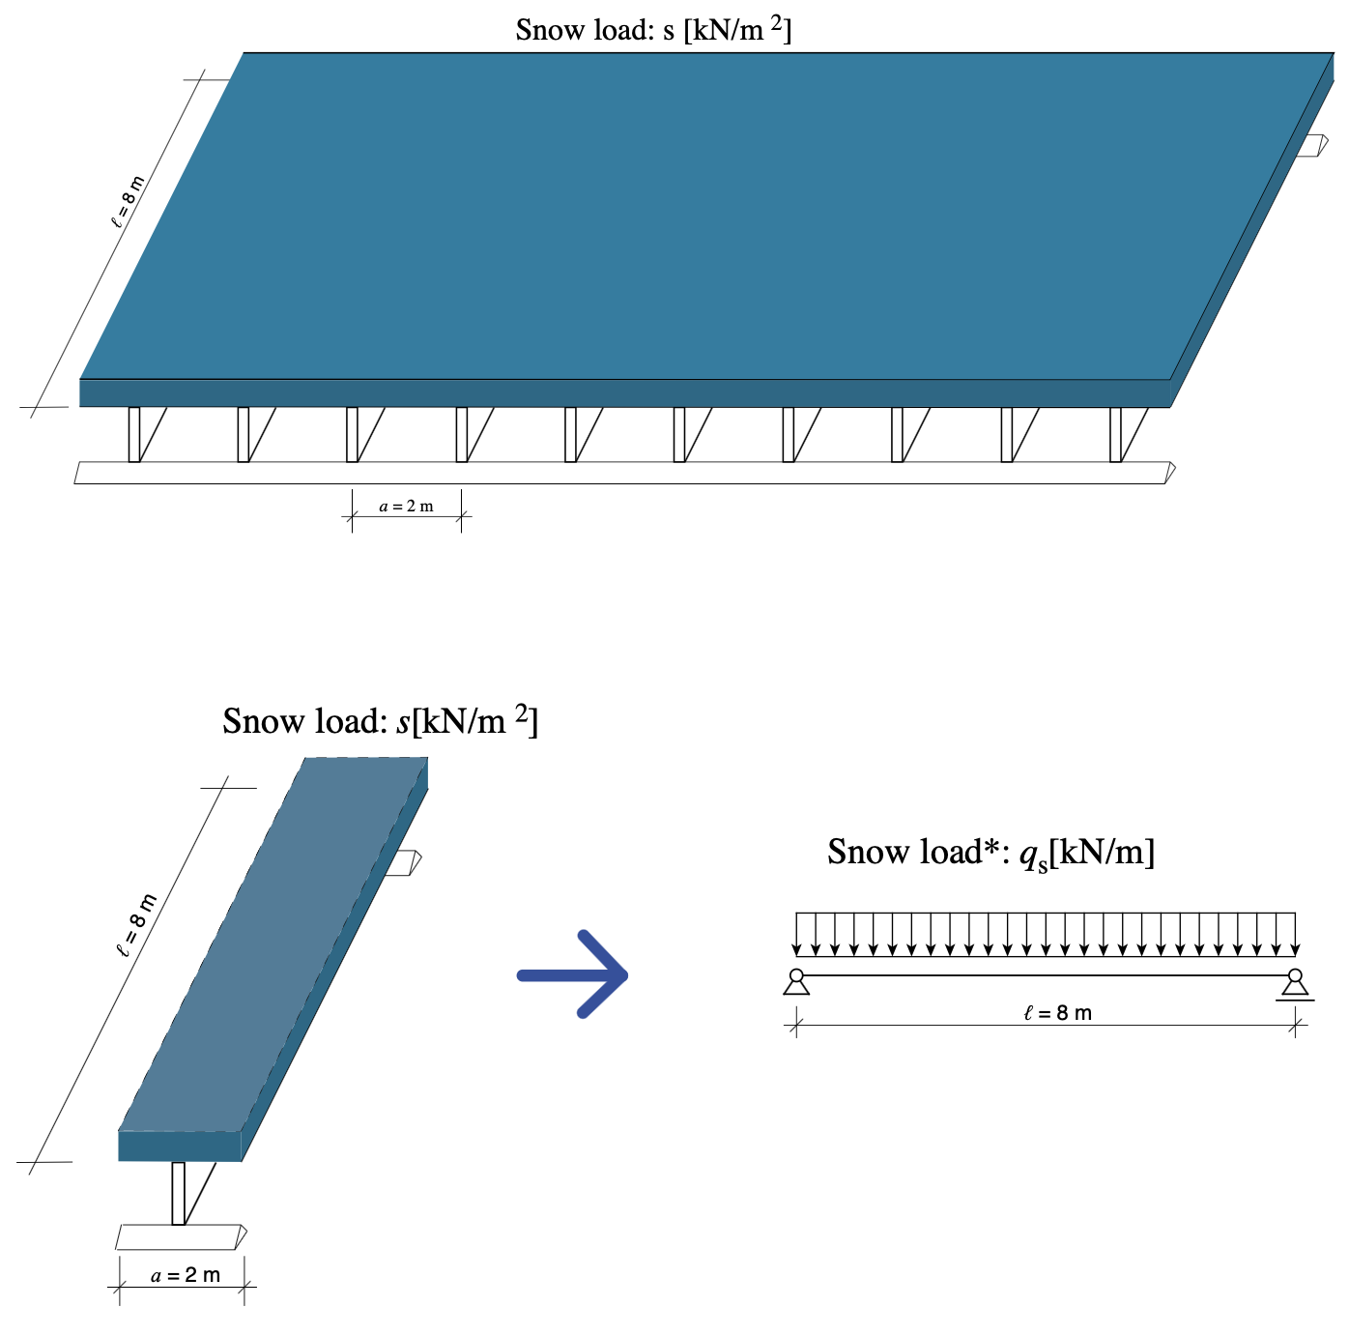

Slide 9
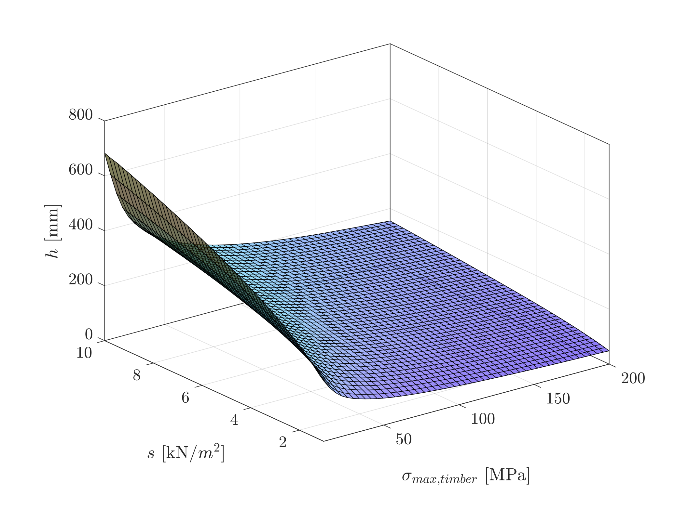
Mechanics: Moment capacity = Loading Moment
!
?
?

Slide 10


Slide 11
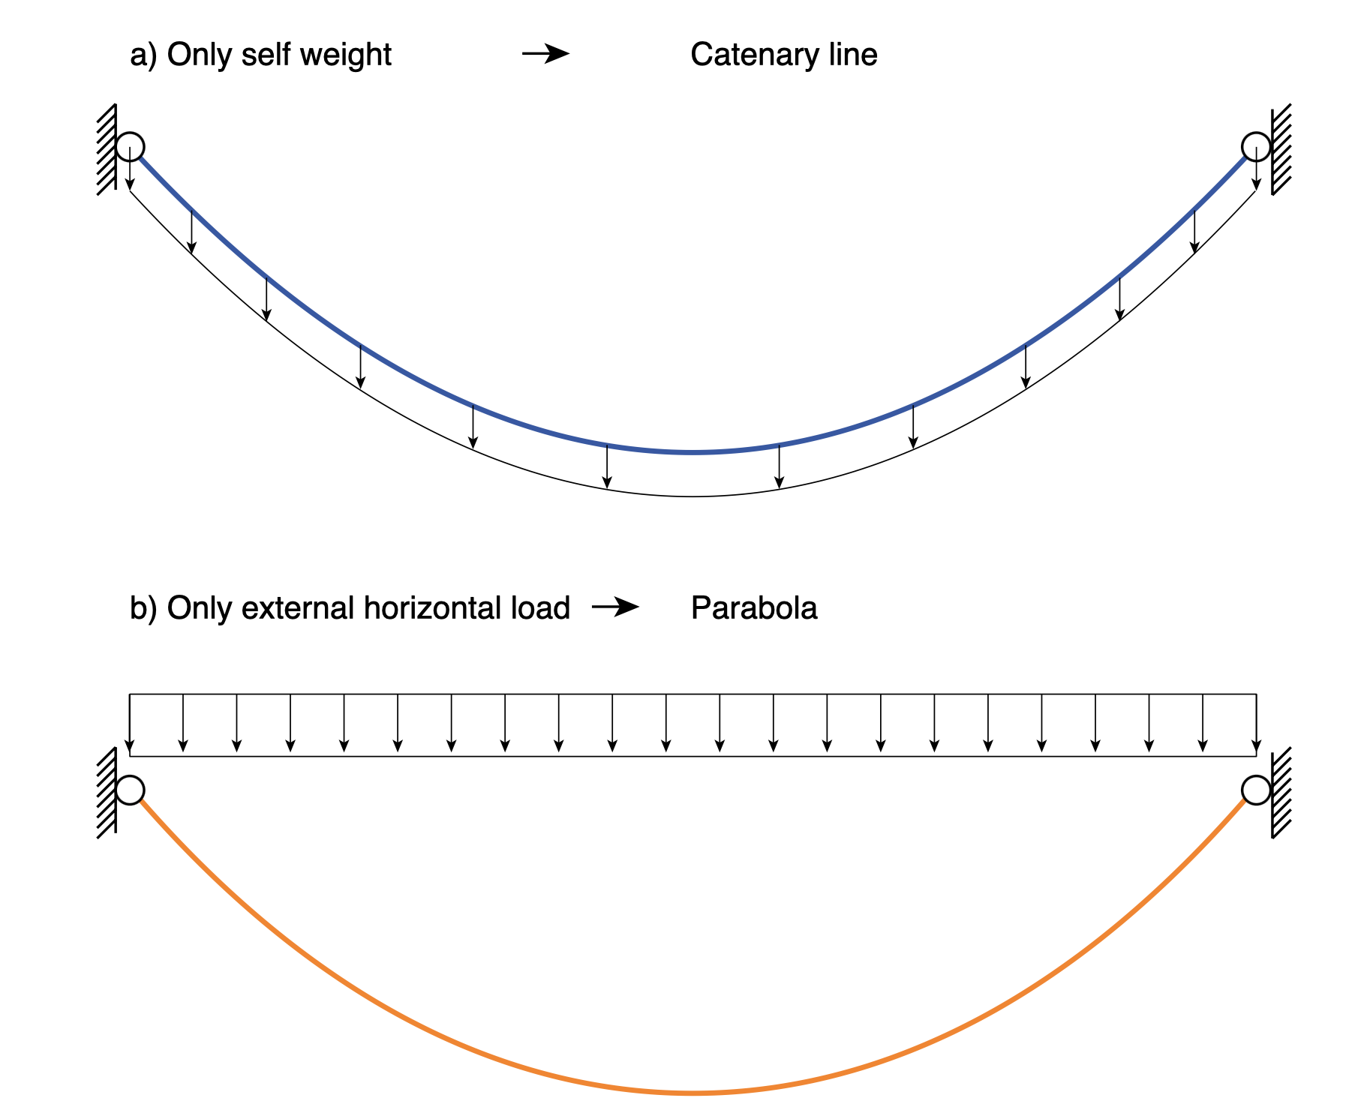

Slide 12


Slide 13
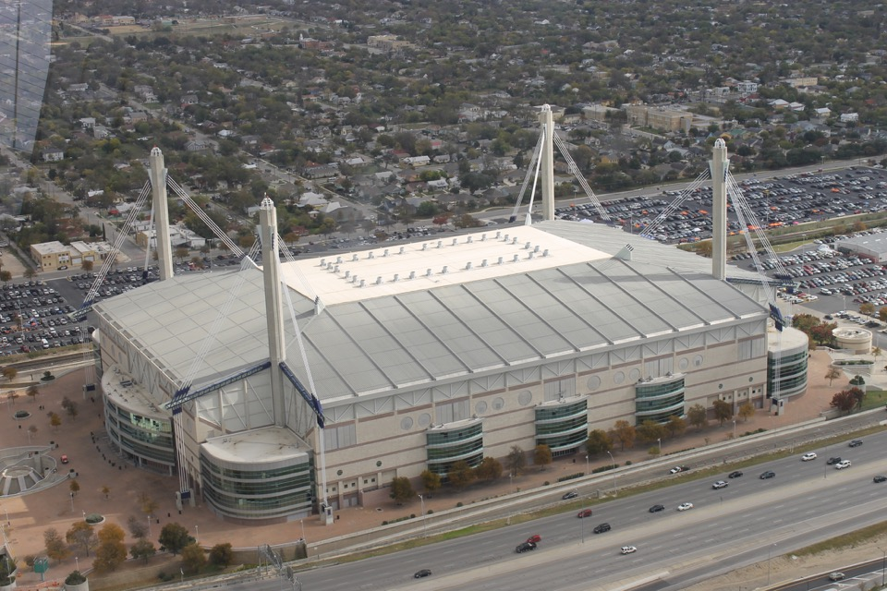

Slide 14


Slide 15


Slide 16
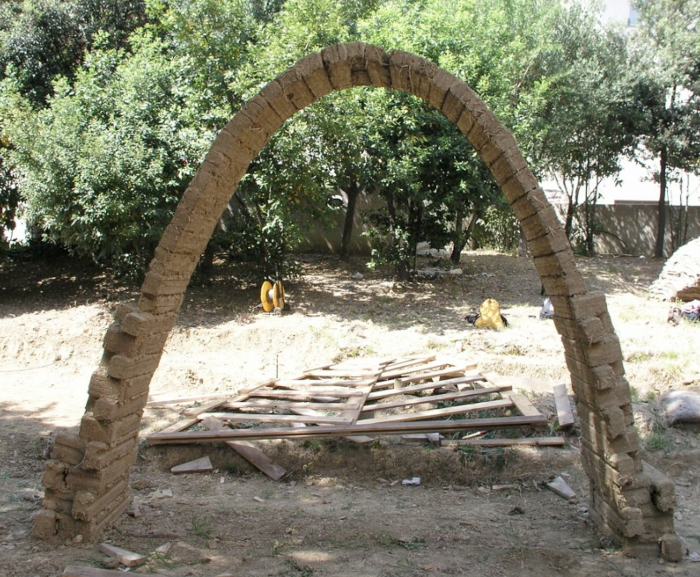

Slide 17


Slide 18


Slide 19


Slide 20


Slide 22


Slide 23


Slide 24


Slide 26


Slide 27


Slide 31


Slide 35
