Slide 1
Samarbeid/innovasjonsarbeid for vedlikeholdsstyring
Workshop NTNU/Statens vegvesen
9. november 2018, Trondheim
Institutt for konstruksjonsteknikk, NTNU
Notes:
Fra innkalding: En første workshop med NTNU og Statens vegvesen for å etablere et samarbeid/innovasjonsarbeid for vedlikeholdsstyring.

Slide 2
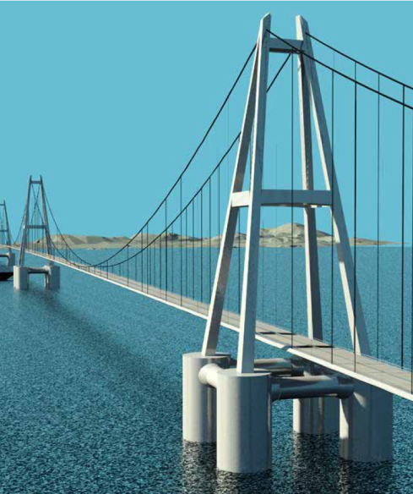
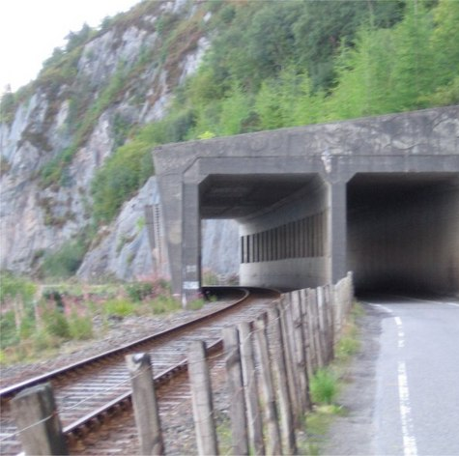
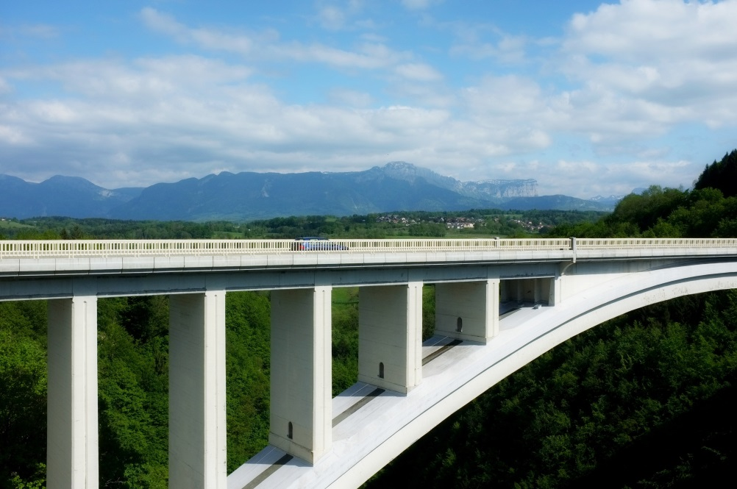
Structural Engineering
  The management of the build infrastructure involves structural analysis.
  Structural analysis is the basis for demonstrating compliance with criteria regarding:
  Safety
  Serviceability
  Durability
  Structural analysis of existing structures is technically challenging and includes several research areas that are represented at KT.
Notes:
Slide fra Jochen Kohler
Added text 5th November
The management of the build infrastructure requires structural analysis in the planning and design phase, but also in re-assessmentsituations.
Structural analysis is the basis for demonstrating compliance with criteria regarding:
Safety
Serviceability
Durability
These are attributes we generally understand as “performance”.
Structural analysis of existing structures is technically challenging and includes several research areas that are represented at KT.

Slide 3
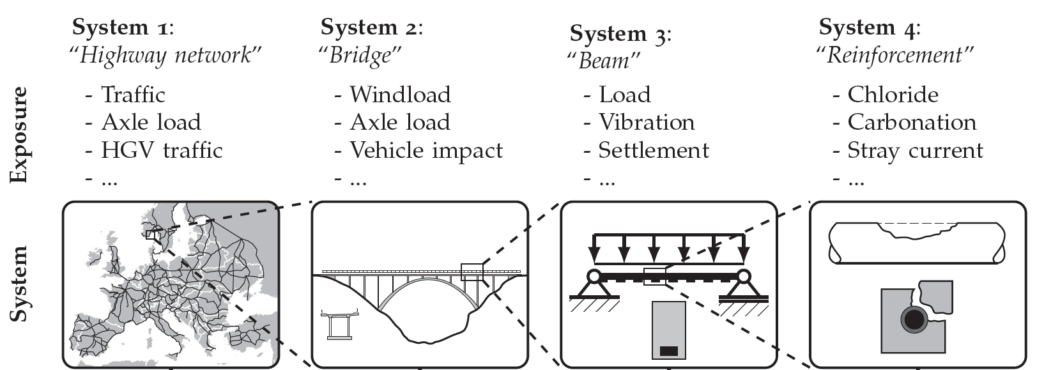
Scientific challenges on different scale levels
Scale hierarchy of
Infrastructure:
Risk
assessment
Structural
reliability
Strength
degradation
Materials
deterioration
KT research activity
and expertise:
KT, NTNU, nov. 2018
Notes:
Slide fra Jochen Kohler
Added text 5th November
It is obvious that infrastructure management requires the consideration of the infrastructure on different scales.
The functionality, resilience and robustness is considered on the interface between network level and object level.
Safety and reliability is assessed on the interface between object and component level.
And deterioration and damage processes are analysed on a local level.
It is important to look at these different scales jointly and KT is active on different disciplines that cover the entire hierarchy.

Slide 4


Challenge on a object level
Spatial distribution of reinforcement corrosion of concrete structures:
[Quin, 2011]
Risk assessment
Structural
reliability
Strength
degradation
Materials
deterioration
Notes:
Slide fra Jochen Kohler
Added text 5th November
Here we see an example of a bridge where the spatial distribution of the probability of corrosion initiation is indicated. This probability represents the outcome of a combination of modelling hypothesis and insitu test.
The information is important and has to be used for the assessment of the residual structural performance, e.g. in terms of structural reliability.

Slide 5
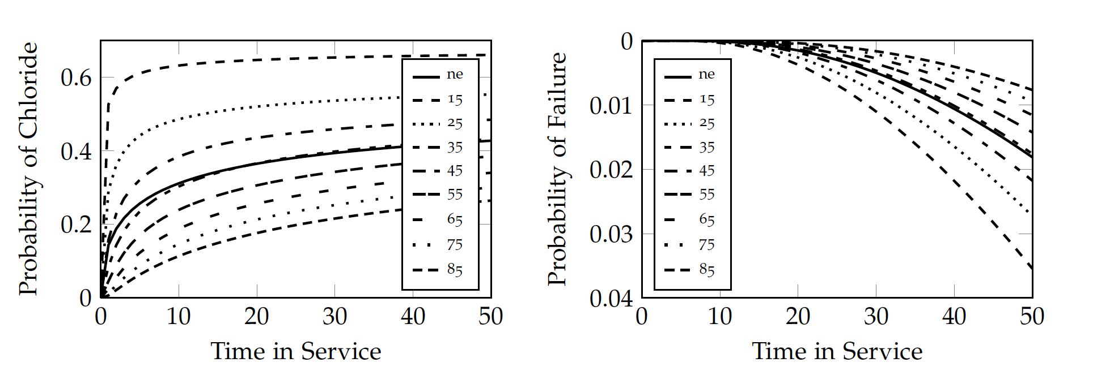
Challenge on a object level
Spatial distribution of reinforcement corrosion of concrete structures:
[Quin, 2011]
Probability of corrosion -> Probability of failure
[Hackl, Kohler, 2013]
Risk assessment
Structural
reliability
Strength
degradation
Materials
deterioration
Notes:
Slide fra Jochen Kohler
Added text 5th November
In these pictures we see how the probability of corrosion initiation and the probability of failure can be estimated conditional on evidence on the concrete cover.

Slide 6
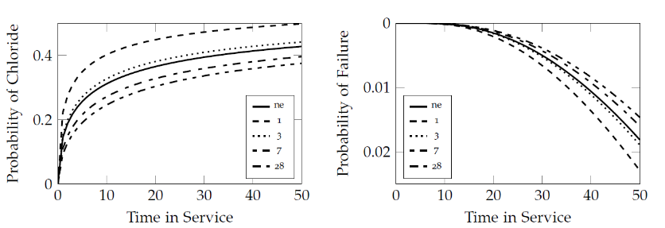
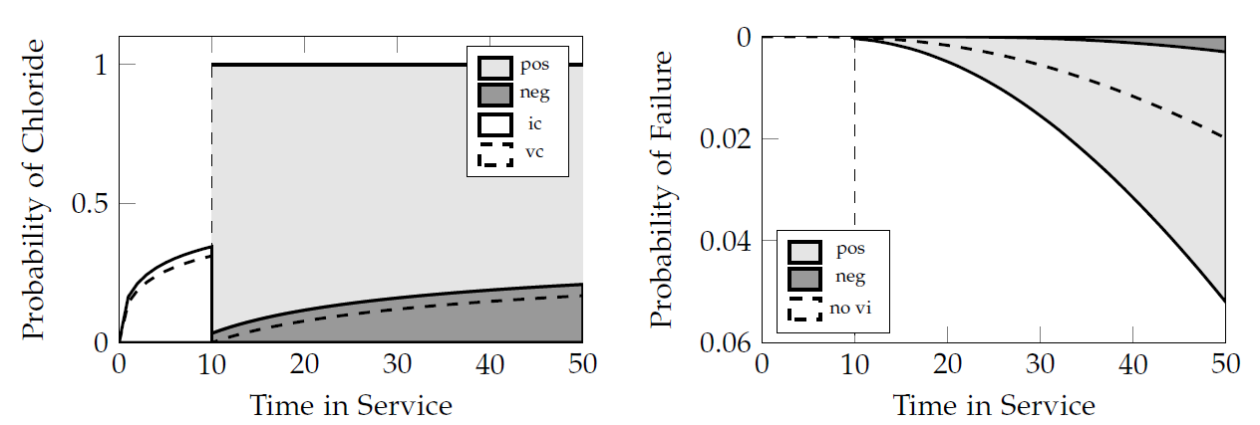
Challenge on a object level
Spatial distribution of reinforcement corrosion of concrete structures:
[Quin, 2011]
Probability of corrosion -> Probability of failure
The effect of inspection and repair
[Hackl, Kohler, 2013]
Risk assessment
Structural
reliability
Strength
degradation
Materials
deterioration
[Hackl, Kohler, 2013]
Notes:
Slide fra Jochen Kohler
Added text 5th November
The effect of inspection and repair on the probability of corrosion initiation and the probability of failure can be estimated. This is considered crucial information when it comes to the safe and cost effective management of infrastructure!!
Added 4th Nov 2018, Geiker (Geiker et al. IALCCE 2018)
In the near future we see the introduction of novel inspection & assessment strategies and methods, including digital twining of physical infrastructure systems in cyberspace.
Looking further forward, we see management undertaken through integrated monitoring and mechanism-based assessment. In the distant future, we see an “autonomous transportation infrastructure”.
To support these developments we see the need for
a framework for integrated IMR,
improved understanding and models for the deterioration processes,
improved understanding and models for the structural consequences of deterioration,
improved methodologies for IMR,
improved basis for decision making (selecting IMR strategies.
We see a large potential in coupling digital twins, advanced methods for data acquisition (sensors, drones, robots) with machine learning using mechanism-based models, e.g. physics informed neural networks.

Slide 7
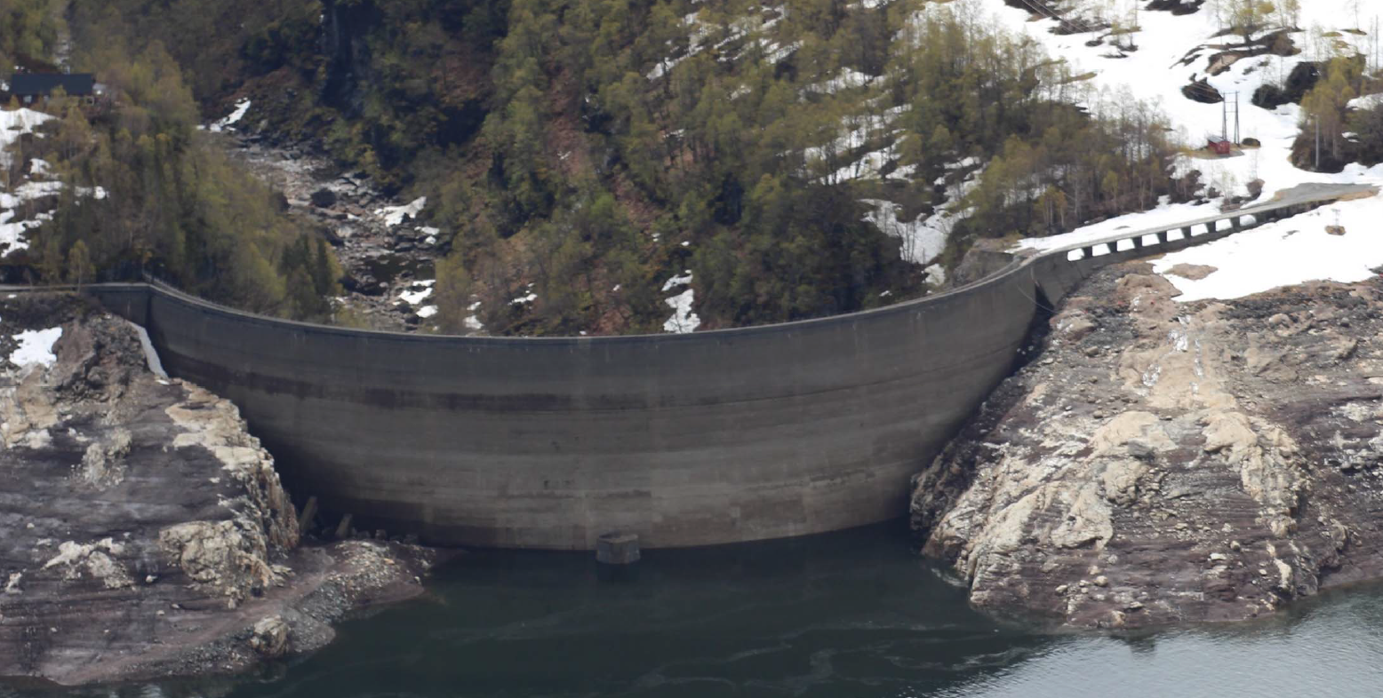
Structural assessement requires reliable data and models
Example: Assessment of dam
Input: Material
Model: NLFEA
Output: Resistance
Knowledge
Knowledge
Knowledge
KT, NTNU, nov. 2018
Notes:
Slide fra Morten Engen / SFI søknadsprosess (endret titel)
(earlier: Example: structural assessment of dam Nonlinear finite element modeling)
Added text 4th Nov, Geiker (text could partly also be used for slide 9)
(text partly from SFI application notes, partly based on (Geiker et al. IALCCE 2018))
Environmental and economic demands stresses the need for innovation in materials, design and processes used for establishing and maintaining a sustainable transportation infrastructure.
We want to
Promote safe reuse and continuous use of our aging infrastructure, and
optimized operation and maintenance of coming structures
To support this we need
a) Digital frameworks for parametric and computational design
b) Improved – and validated - calculation models and input data to obtain
optimized operation and maintenance
more accurate estimated reliability
less conservative assessment
avoid costly unnecessary demolishing and strengthening
Sustainable design and maintenance of reinforced concrete structures requires both engineering and sustainability limit states be considered.

Slide 8
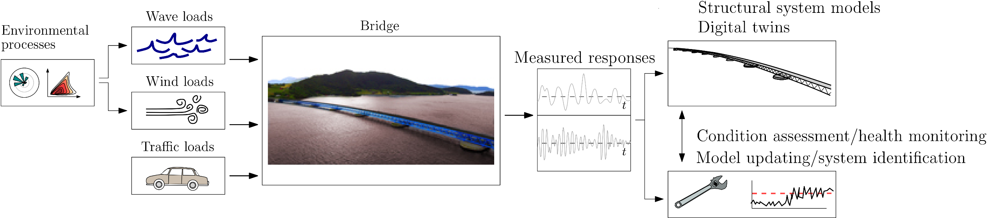
Inspection and assessment
Example: Monitoring of structural dynamic response and local wind/waves
Monitoring
Digital twin
Data tells an important story
Assessment of prediction model uncertainties
Estimation of the full-field global bridge response
Identification of loads
Finite element model updating for calibration
Health condition assessment
KT, NTNU, nov. 2018
Notes:
Slide fra Anders Rønnquist (mindre endringer)
Supplerende info fra Ole Øiseth til Kalle:
Denne artikkelen oppsummerer litt hvorfor en skal instrumentere bruer: http://www.samfunnsutvikling.com/infrastruktur/leter-etter-nye-inspeksjonsmetoder
Noen stikkord:
Det er en fordel å vite hvordan brua er etter den er bygget. Oppdaterte elementmodeller. Kvantifisering av egenskaper knyttet til stivhet, demping, frekvenser. Lettere å identifisere skade senere.
Hvordan kan en benytte instrumentering til å evaluere tilstand og restlevetid? Skal en måle i korte perioder samtidig med inspeksjon eller skal en måle kontinuerlig.
Bruk av kunstig intelligens for å velge ut dataseries som må evalueres nærmere. Det blir fort mye data.
Ny sensorteknologi. Nye typer sensorer, mer robust instrumentering, billige sensorer.
Hovedutfordringen i dag er at en typisk har mye problemer med instrumenteringen, noe som gjør at vinninga går opp i spinninga. Vi må utvikle nye robuste systemer sammen med folk fra elektro.
Vi har erfaring med å utvikle og bygge sensorsystemer, men det hadde sikkert vært fint å få med noen fra elektro eller reguleringsteknikk.

Slide 9
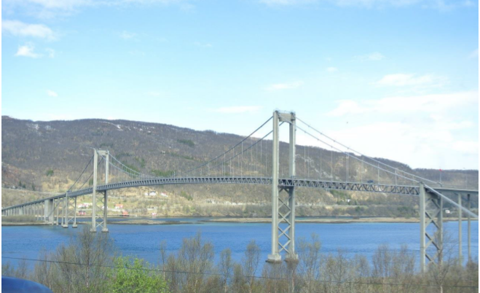
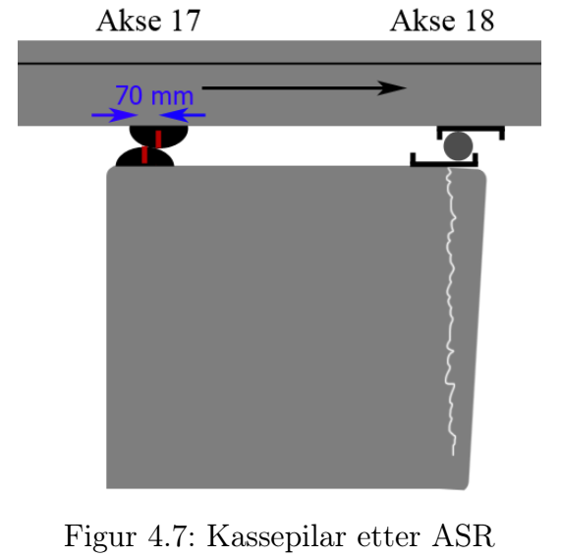
Inspection and assessment
Example: ASR & frost, Tjeldsundet bridge, (300m suspension bridge, 500m viaduct)
Status and questions
Cost estimate for a new bridge: 600 mill NOK
What is the remaining working life?
Economy and environmental consequences?
How to optimize inspection, assessment, maintenance and repair?
KT, NTNU, nov. 2018
Notes:
Slide fra Terje Kanstad / SFI søknadsprosess (mindre endringer)
Demonstrator identifisert som potensjel prosjekt i SFI søknad
IMR: Inspection maintenance and repair
Objectives of potential demonstrator/potential project
Application of framework
Field data
Structural assessment
Potential development of methodologies.
Discussion of strategies
Added text 4th Nov, Geiker (Geiker et al. IALCCE 2018) (see also text to slide 7)
Our transportation intrastructure (see numbers in added last slide)
Reinforced concrete structures - a central part
The bridges are getting into their repair age
Maintenance backlog
Norwegian national and county transportation structures;
Primary reasons for insufficient performance of Bridges from 1970’ies
Causing chloride induced reinforcement corrosion
Mixed in chlorides (mixing water, sea-dredged aggregates, accelerator)
Small cover
Causing alkali-silica reactions
Use of reactive aggregates

Slide 10
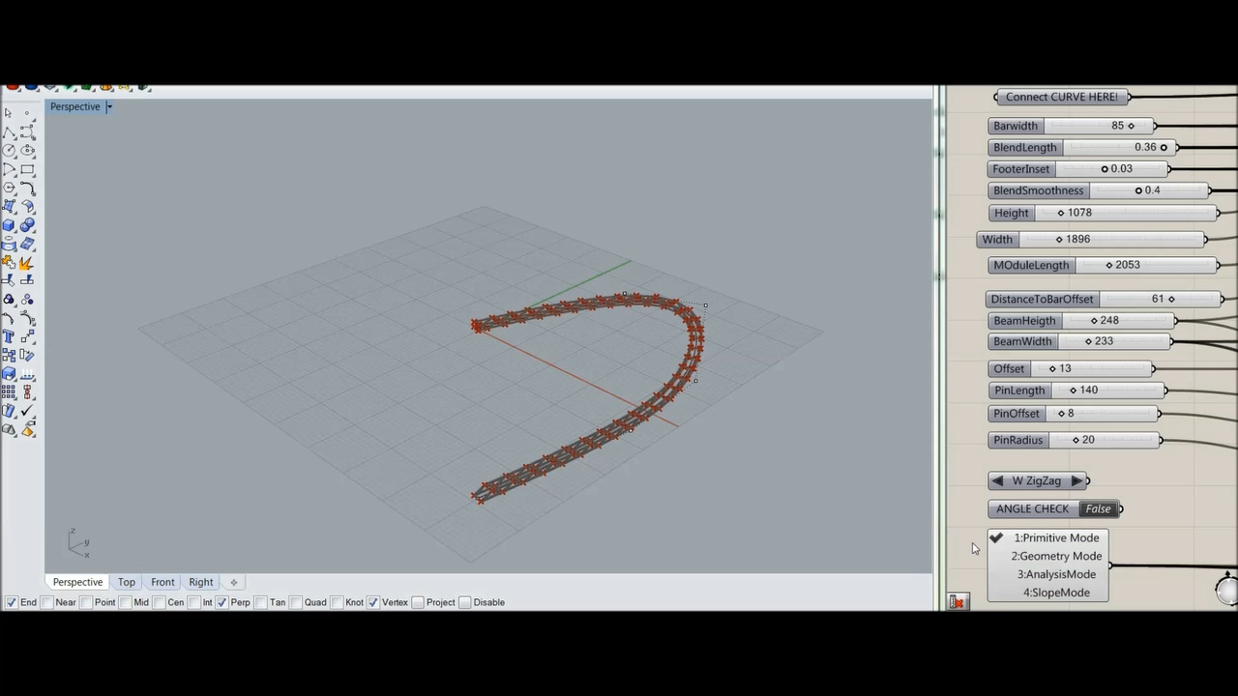
Conceptual structural design and redesign supports productivity and innovation
Example: design optimization of bridge
KT, NTNU, nov. 2018
Notes:
Slide fra Anders Rønnquist (endret title)
(Bridge - structural concepts)

Slide 11
Norwegian national and county transportation structures
- in numbers
Maintenance backlog, bridges and harbor structures (2013): 11-18 billion NOK
Notes:
Added slide 4th Nov, Geiker (Geiker et al. IALCCE 2018)
Background
Norwegian national and county transportation structures in numbers
Our transportation infrastructure (see numbers in added last slide)
Reinforced concrete structures - a central part
The bridges are getting into their repair age
Large maintenance backlog

